Slide 1
110
Carmen leon

Slide 2
History

Slide 3
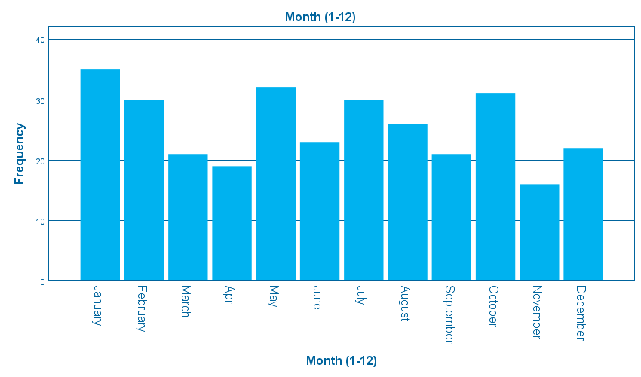

Slide 4
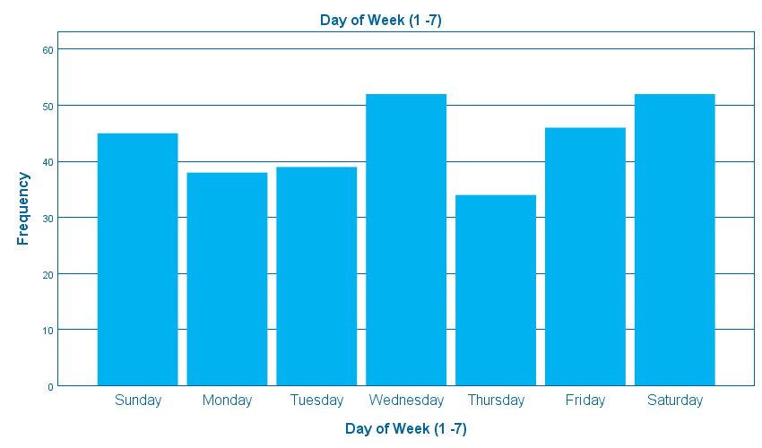

Slide 5
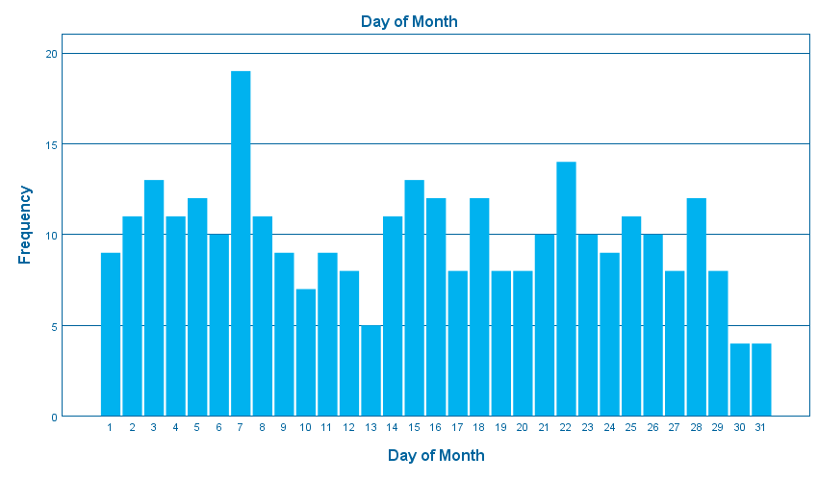

Slide 6
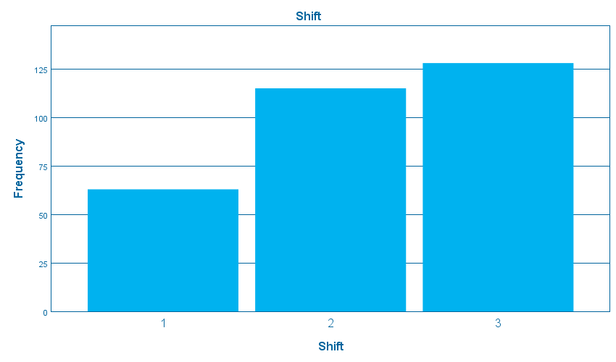

Slide 7
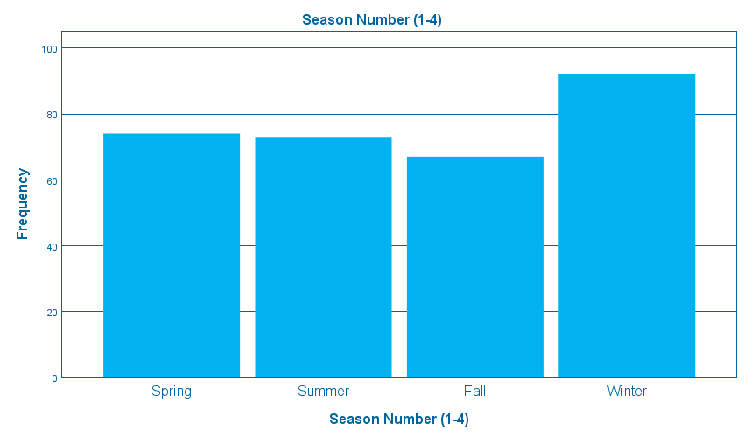

Slide 8
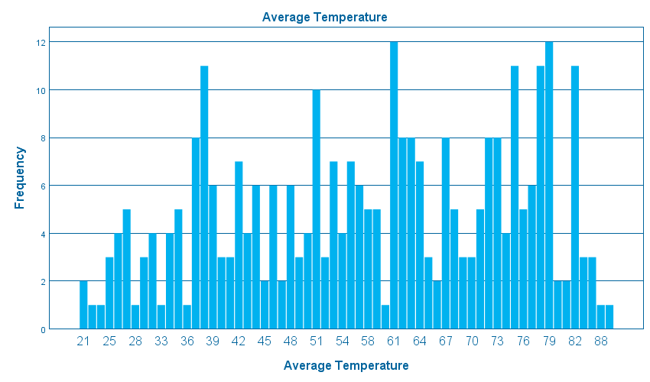

Slide 9
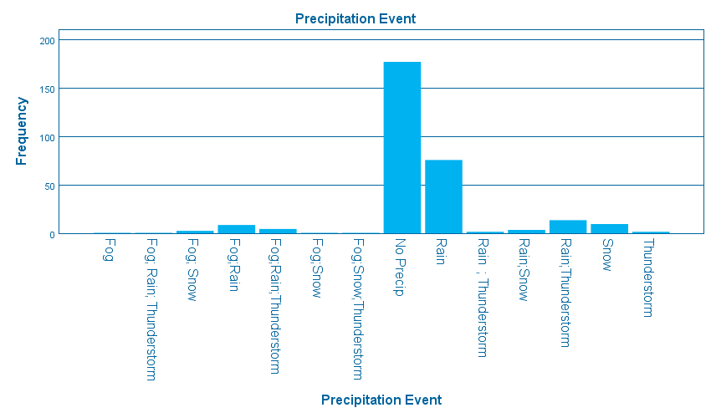

Slide 10
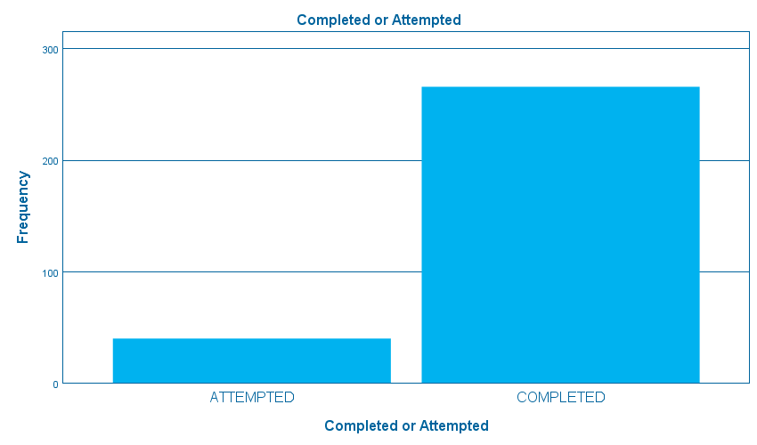

Slide 11
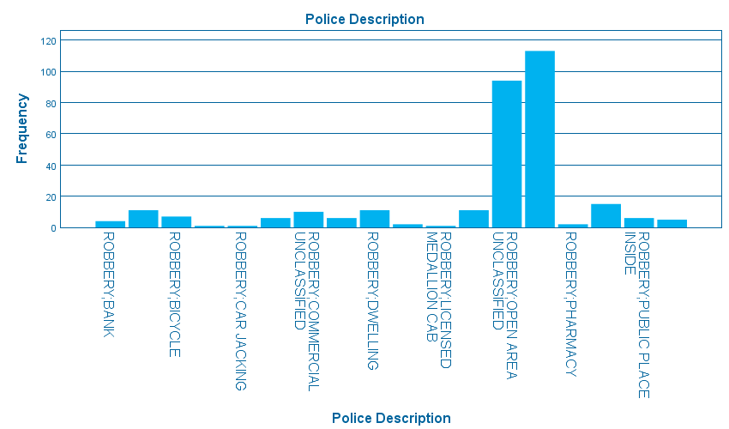

Slide 12
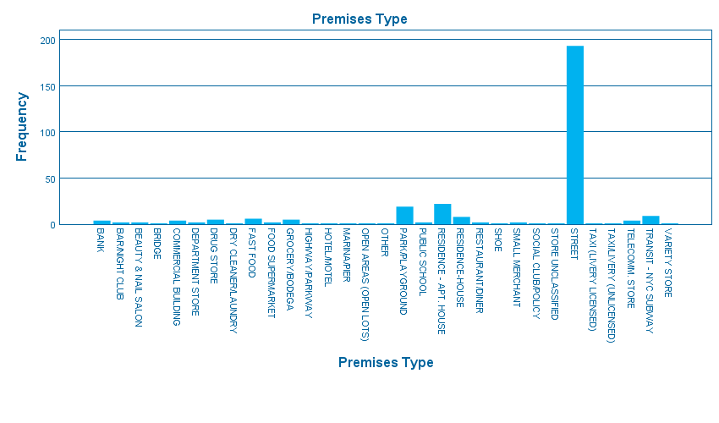

Slide 13
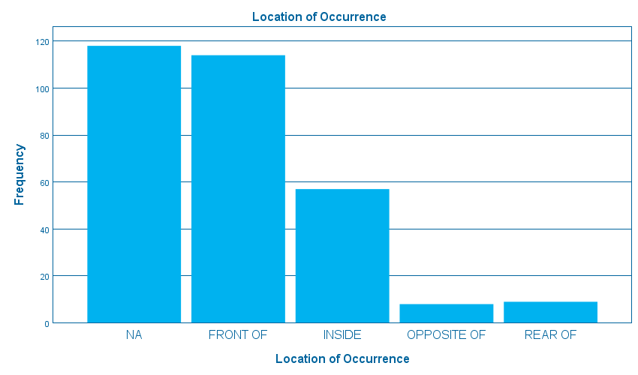

Slide 14
What data does the variable represent, for example, day of the week, date, month, etc.?

Slide 15
What are the highest or peak values for the data shown?

Slide 16
What are the lowest values for the data show?

Slide 17
What do these highs and lows say about robbery in your precinct?

Slide 18
How should these values affect robbery prevention strategies in your precinct?

Slide 19
Think about each variable as you analyze it and come up with some of your own analysis questions to answer

Slide 20
extra

Slide 21
extra

Slide 22
extra

Slide 23
extra

Slide 24
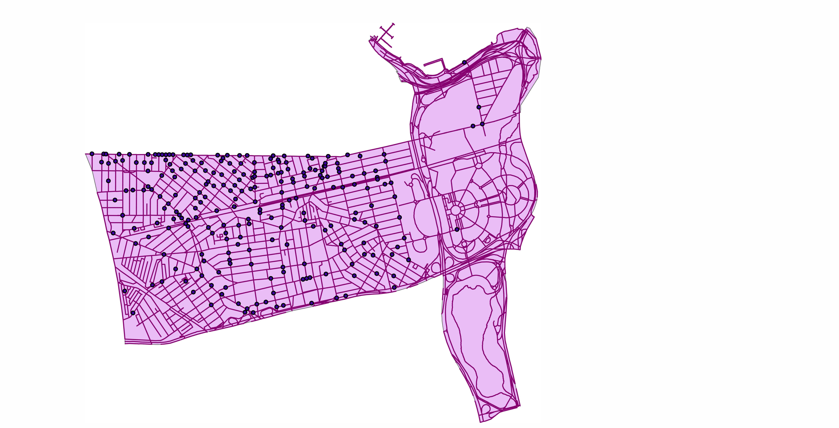

Slide 25
Does the data show clusters around a certain area in the precinct?

Slide 26
Do any cluster relate to special attractions or circumstances in your precinct?

Slide 27
Think about the map and come up with some of your own analysis questions to answer.

Slide 28
extrA

Slide 29
EXTRA

